Slide 1
VUMC Core Managers Meeting
iLab & Workday Integration
March 14, 2023

Slide 2
iLab and Workday Integration
  iLab Cutover Planning & Monthly Close Schedule
  Transition Best Practices & Resources
  Q & A
NIH Data Management & Sharing Policy
Environmental Sustainability
Stronger together: Call to Action
Agenda
Today’s meeting will be recorded and published to the OOR website.

Slide 3
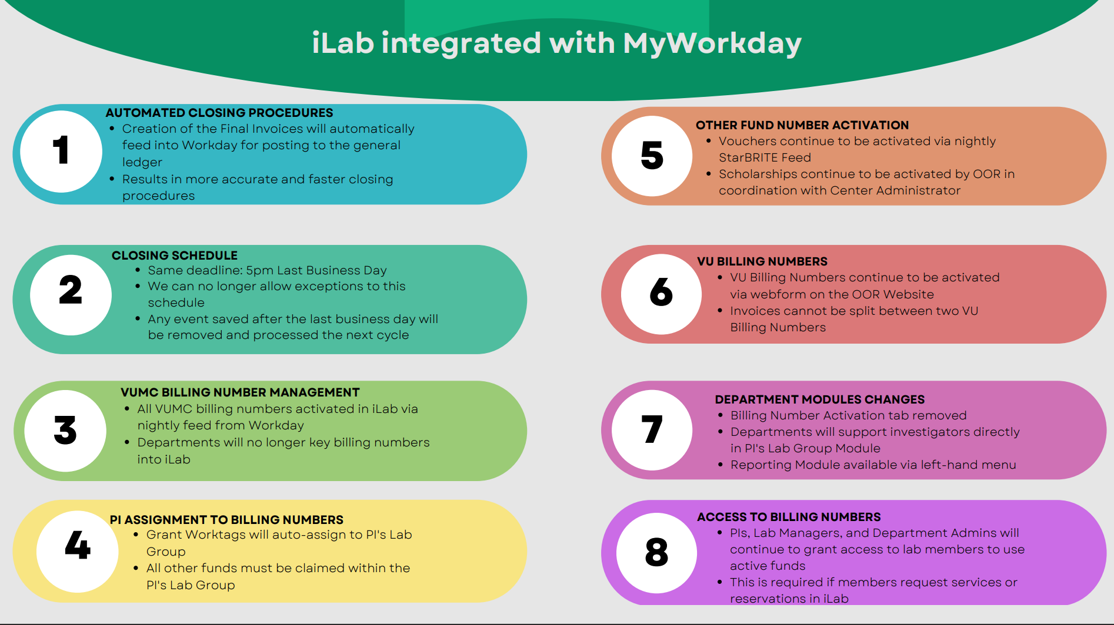

Slide 4
iLab Cutover Planning & Close Schedule
iLab will be unavailable from 10:00 a.m. on Saturday, April 1st to 1:00 p.m. on Sunday, April 2nd.
March 2023 billing events must be created by March 29th.
VUMC Core Billing Closing Schedule: March 2023
Wednesday, March 29, 2023: | VUMC Core facility order entry deadline at 5 p.m.
Thursday, March 30, 2023: | Pending charges available for PI/Departmental review and/or correction by 10:00 am.
Friday, March 31, 2023: | Office of Research conducts VUMC iLab close starting at 10:00 am. Final invoices are created and submitted to VUMC Finance for upload to the General Ledger. Corrections in the system are no longer possible.
Billing events saved after the last business day of the month will not be processed until the following month.

Slide 5
All legacy Cost Centers expired 3/31/2023
Crosswalk file
Cores using iLab Workflow Functionality
Cross managing workflow / service tracking outside of iLab
One-time mapping of all legacy cost centers to the new Workday billing number (i.e, cost center, grant worktag, gift worktag, program worktag)
Open Reservation events on iLab calendars will auto-update to the new workday value
Open iLab Service Projects will auto-update to new workday value
Reach out to your customers to obtain the correct Workday billing number.

Slide 6


Workday & iLab Integration Wins:
Increased accuracy with the automated import of VUMC billing numbers.
Improved efficiency of closing procedures with the integration between Workday and iLab invoicing processing.
Our request of Cores:
Engage with your customers to ensure you are billing the correct Workday billing number in April.
Cores are expected to bill timely for services provided. Create and save all billing events by the last business day of each month.
Reminder: Charges will a red flag will need to be resolved. Please contact the Office of Research for assistance understanding how to resolve billing errors.
We will provide templates to help you communicate billing number management processes.

Slide 7
Resources
Office of Research Website: iLab Support Section
Updated core manager guides
Updated core user guides
Support Team available at vumccores@vumc.org.

Slide 8


Slide 9

2023 NIH Data Management & Sharing (DMS) Policy
Implications for Cores

Slide 10
2023 NIH Data Management & Sharing (DMS) Policy
All NIH awards expected to generate scientific data must now submit and follow a data management & sharing plan
  Note: does not apply to infrastructure/equipment grants
Data sharing is required for most types of research
  Data should be shared ASAP (upon publication or end of award period)
PI submits 2-page DMS Plan with grant application
NIH Program Office reviews & provides feedback
PI must adhere to the approved plan and report on progress & changes
*Data costs allowable in budget
https://sharing.nih.gov/data-management-and-sharing-policy

Slide 11
Supporting best practices in data management
Cores already exemplify rigor, reproducibility and transparency in experimental design and data production
Cores can further support investigators in their data management and sharing efforts by maintaining clear & accessible Core data policies and sticking to them
Cores should:
  Define what constitutes data (& metadata)
  Have clear policies/procedures for data transfer
  Have clear policies/procedures for data retention and deletion
  Describe any long-term data storage and/or sharing services and associated costs
  Adhere to the policies they set in place

Slide 12
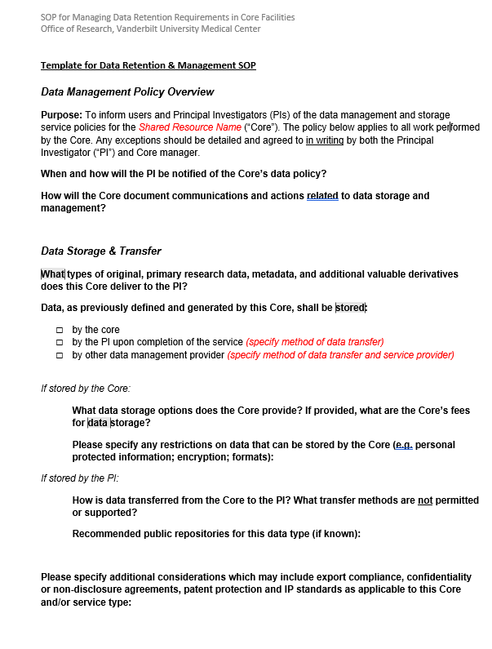
Core Data Management SOP
Each Core should describe its data policies/practices in a published Data Management SOP
OOR template helps Core leaders think through data management considerations and create a <2 page Data Management SOP
Each Core should submit a filled template to OOR by September 30

Slide 13
Environmental sustainability
Opportunities for Cores

Slide 14
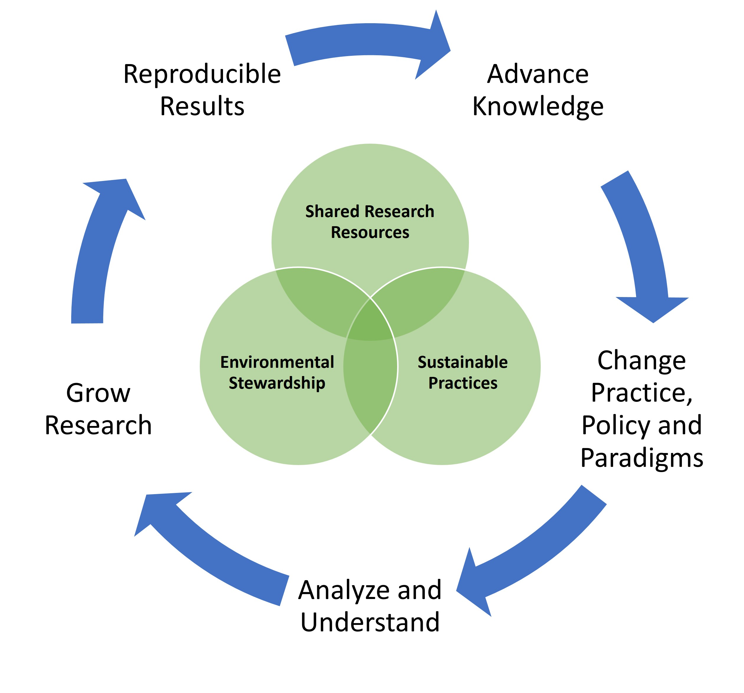
Cores Lead the Way in Sustainability
Expertise + rigor + economies of scale
= Effective and ethical resource use
= Lower costs and environmental impact
Cores already help address the environmental impact of science through rigorous, reproducible, and sustainable conduct of research (JBT 2023)
Find additional ideas for “greening” your lab at: www.vumc.org/oor/research-sustainability
Meyn, et al. 2023

Slide 15


The I²SL + My Green Lab Freezer Challenge promotes best practices in cold storage to promote energy efficiency, sample integrity, and sample access.
Earn points for: clearing out old samples, tuning temperatures, using high-density storage, cleaning filters/coils, clearing frost, barcoding inventories, recruiting a friend…
Sign up, get a scoresheet, and record any actions taken to optimize your Core’s cold storage practices. Retroactive to 8/1/22!
Submit your scoresheet by 7/1/23: https://www.freezerchallenge.org/
Awards given to labs & institutions
Top-scoring VUMC Core or research lab will be recognized with an official announcement and a group lunch!
Contact amy.f.martinez@vumc.org or see https://redcap.link/9fh2zoda for instructions on entering VUMC’s contest
Up for some friendly competition?
https://www.freezerchallenge.org/

Slide 16

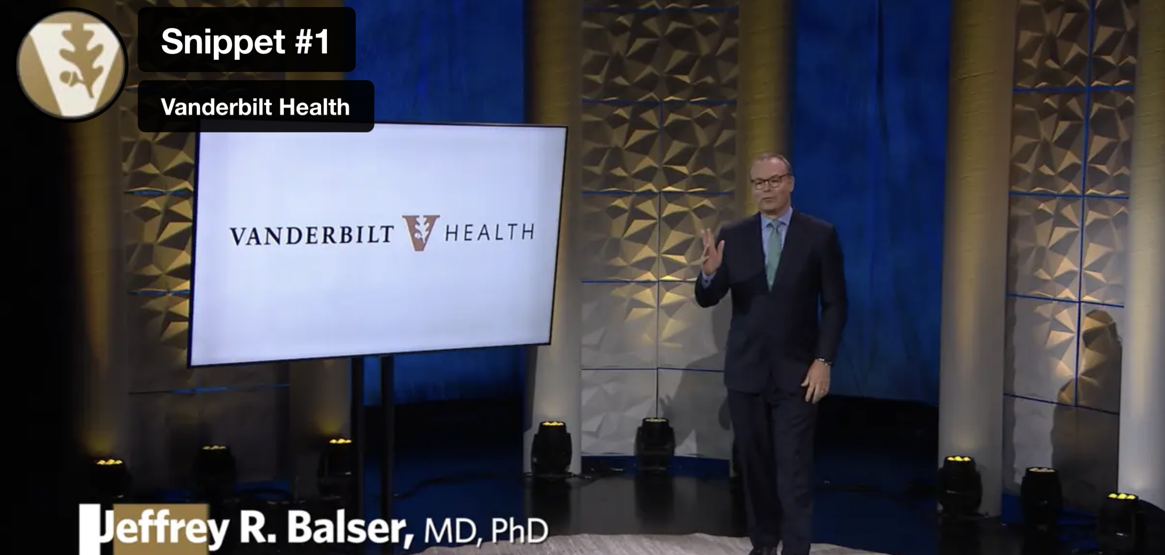
Stronger together:
Call to Action
https://www.vumc.org/elevate/stronger-together-1
VUMC finances have been strained post-pandemic (e.g., high cost of travel nurses, industry exits, maxed-out hospital capacity).
Our labor costs increased by 30%, while revenue growth <5% each year.
We must still maintain/update facilities, replace outdated equipment, add new clinic space while still supporting research and training missions.
Goal: Reduce our spending by 6% without furloughs or layoffs.
We need your help to identify solutions to help us reduce costs and operate more efficiently. The best ideas come from all of us!
Send your ideas to s.meyn@VUMC.org:
What opportunities do you see in your daily work for VUMC to save money and be more innovative/smarter in how we operate?
Do you have other ideas for reducing costs or operating more efficiently at VUMC?

