Slide 1
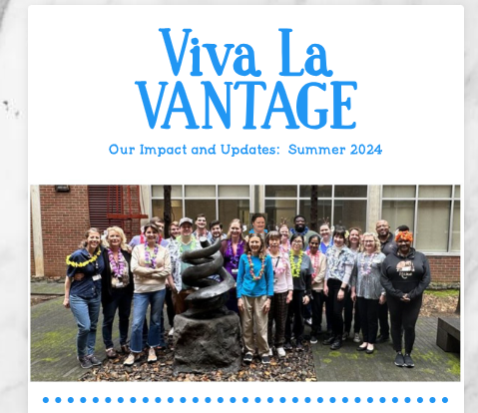
Angela Jones and Karen Beeri, VANTAGE
The work of our cores matters, its great to lift our head occasionally and check out what impact we have and what do others in our team do

Slide 2
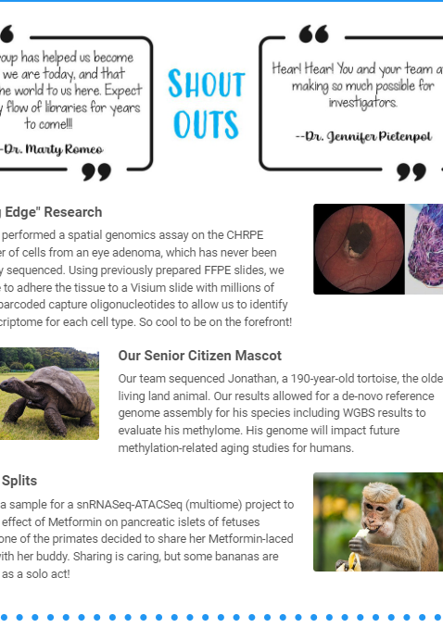
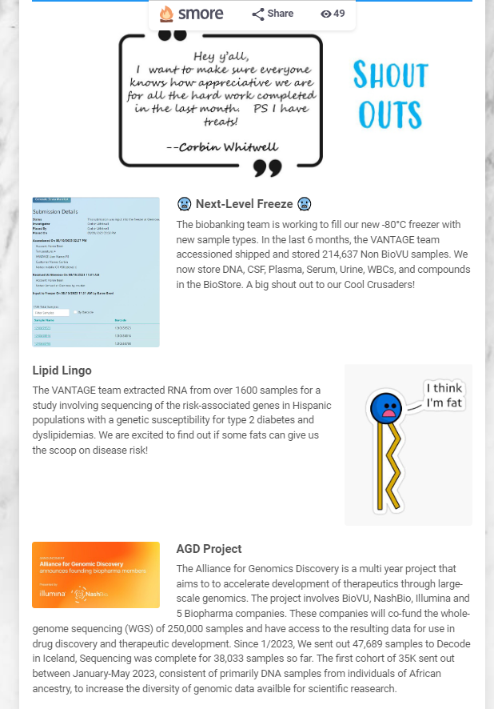
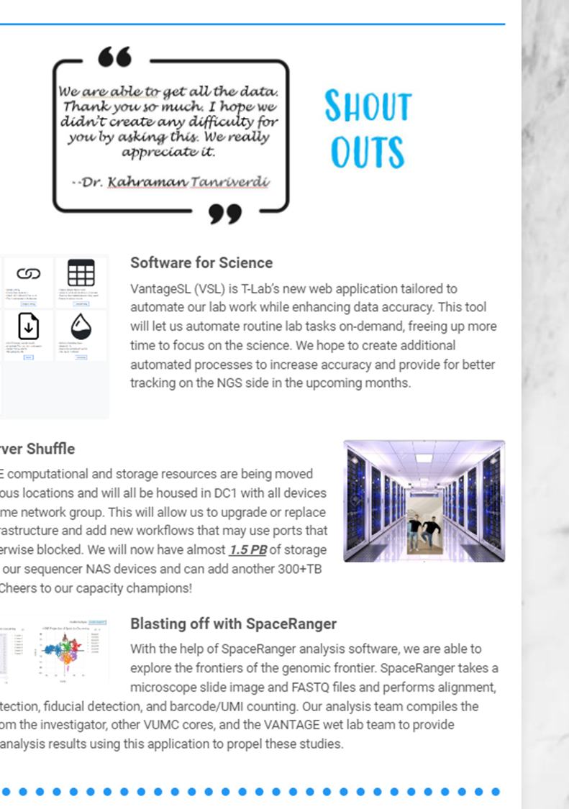

Slide 3
