Slide 1

Pilot Funding Program Application Management
Lesa Black, PhD
Research Services Consultant III, VICTR

Slide 2


Pilot funding for clinical and translational hypothesis driven projects that involve human subjects, tissue, cell lines and/or information (e.g. medical records), and have application to human health
VUMC, VU and MMC faculty, medical students and fellows are eligible to apply
Available resources include labs, cores, supplies, studios, biostat, recruitment support, and more
Access to the Clinical Research Center for Industry, NIH and foundation funded studies

Slide 3
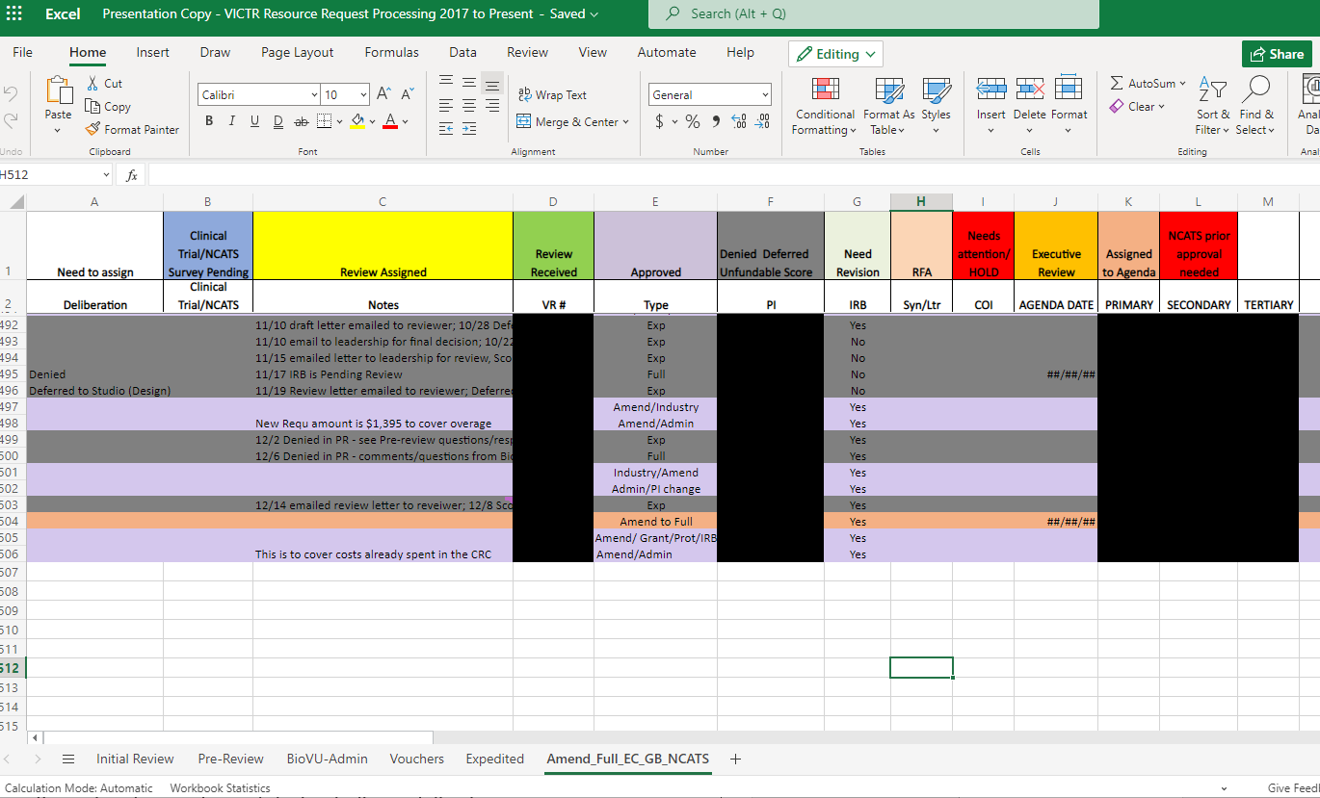
Microsoft Office 365 Live Excel Spreadsheet
Each step of review process for applications has it’s own worksheet
Removes need for email communication
Color coded legend to note application needs
Work efficiently flows from one team member to the next in real-time

Slide 4
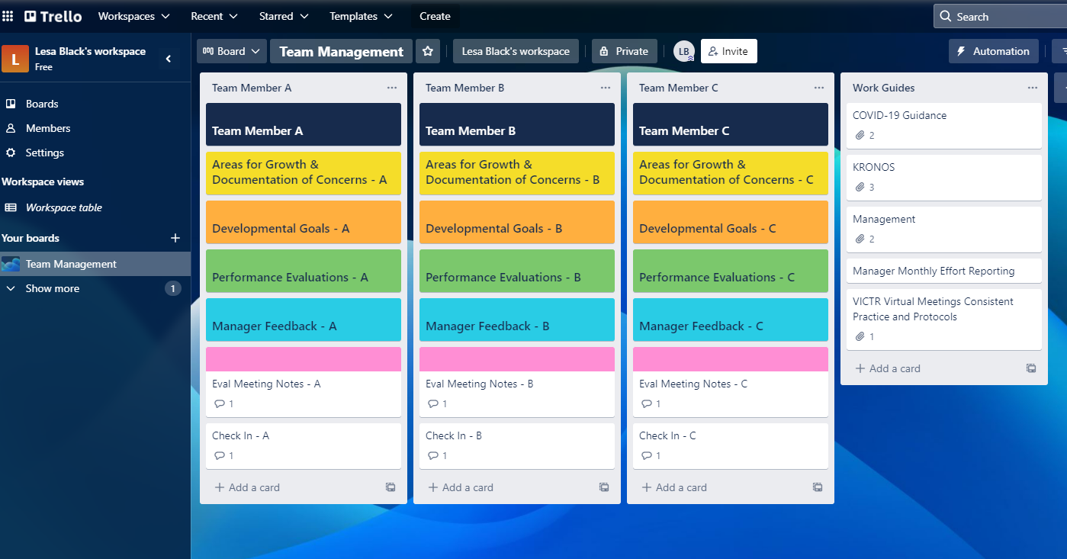
Trello Team Management
Each team member in a list
Each card of a list represents different team member evaluations, feedback, discussions

Slide 5
Overviews and Support Clinics
Monthly VICTR Funding Overviews
2nd Monday of each Month | 10:00am to 11:00am
Join Zoom Meeting: https://zoom.us/j/98747556017
Meeting ID: 987 4755 6017 | +1 312 626 6799 US
No Registration Required
Individual Support Clinics
Receive assistance with VICTR funding applications and
questions about VICTR resources.
https://is.gd/vrrsupportclinicrequest
Group Training Sessions
If you are interested in a group training session, please let us know at
VICTR.Resource.Request@vumc.org | (615) 322-8629

Slide 6
Contact Us
  VICTR/SRC Administration Team
  322-8629 victr.resource.request@vumc.org
Lesa Black, PhD (Research Services Consultant III – Operations Manager)
343-1899 or lesa.black@vumc.org
Christelle Scott (Health Policy Services Analyst II)
343-1745 or christelle.scott@vumc.org
Annette Lantz (Scientific Review Analyst I)
322-8629 or annette.lantz@vumc.org

