Slide 1
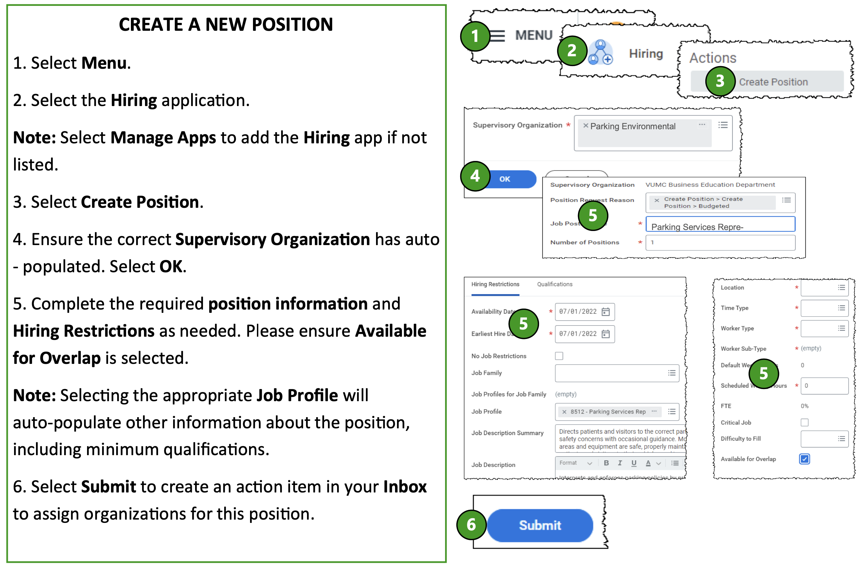
New Positions:
Always create the position before creating the requestion.
If you cannot access the hiring app, search for “Create Position” in workday.
See also:
Use Existing Position

Slide 2
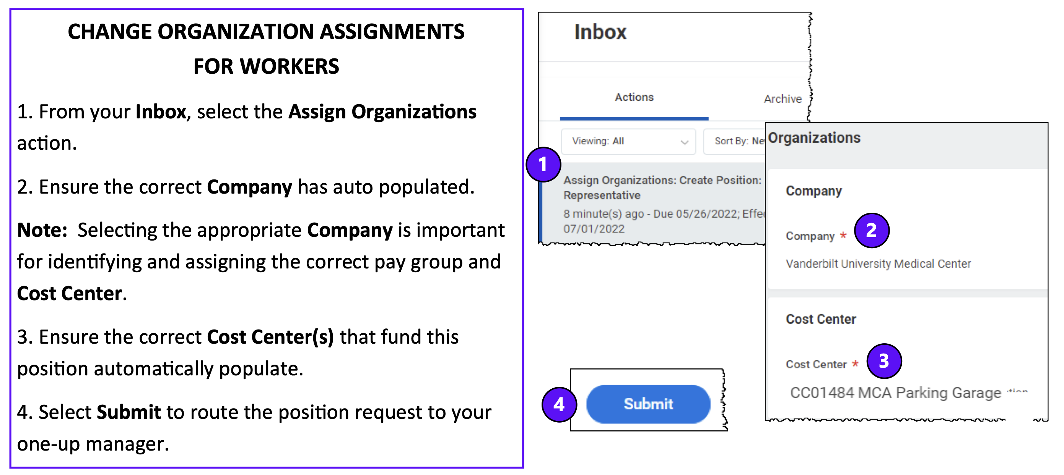

Slide 3
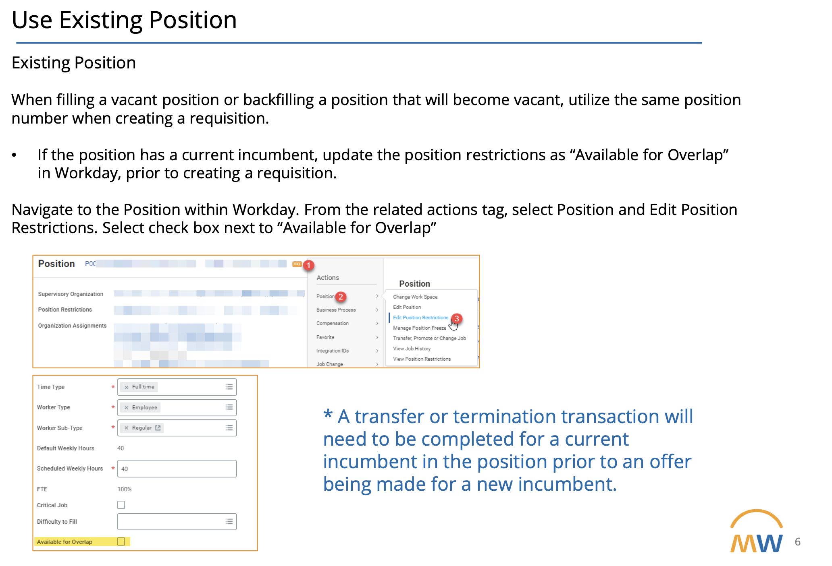
Best Practice:
Use Existing Position for backfilling a position.

